Slide 1

Customer Shopping Behavior Analysis
Analysis of 3,900 transactions to reveal spending patterns, segmentation, product preferences, and subscription behavior to guide marketing and revenue strategy.

Slide 2
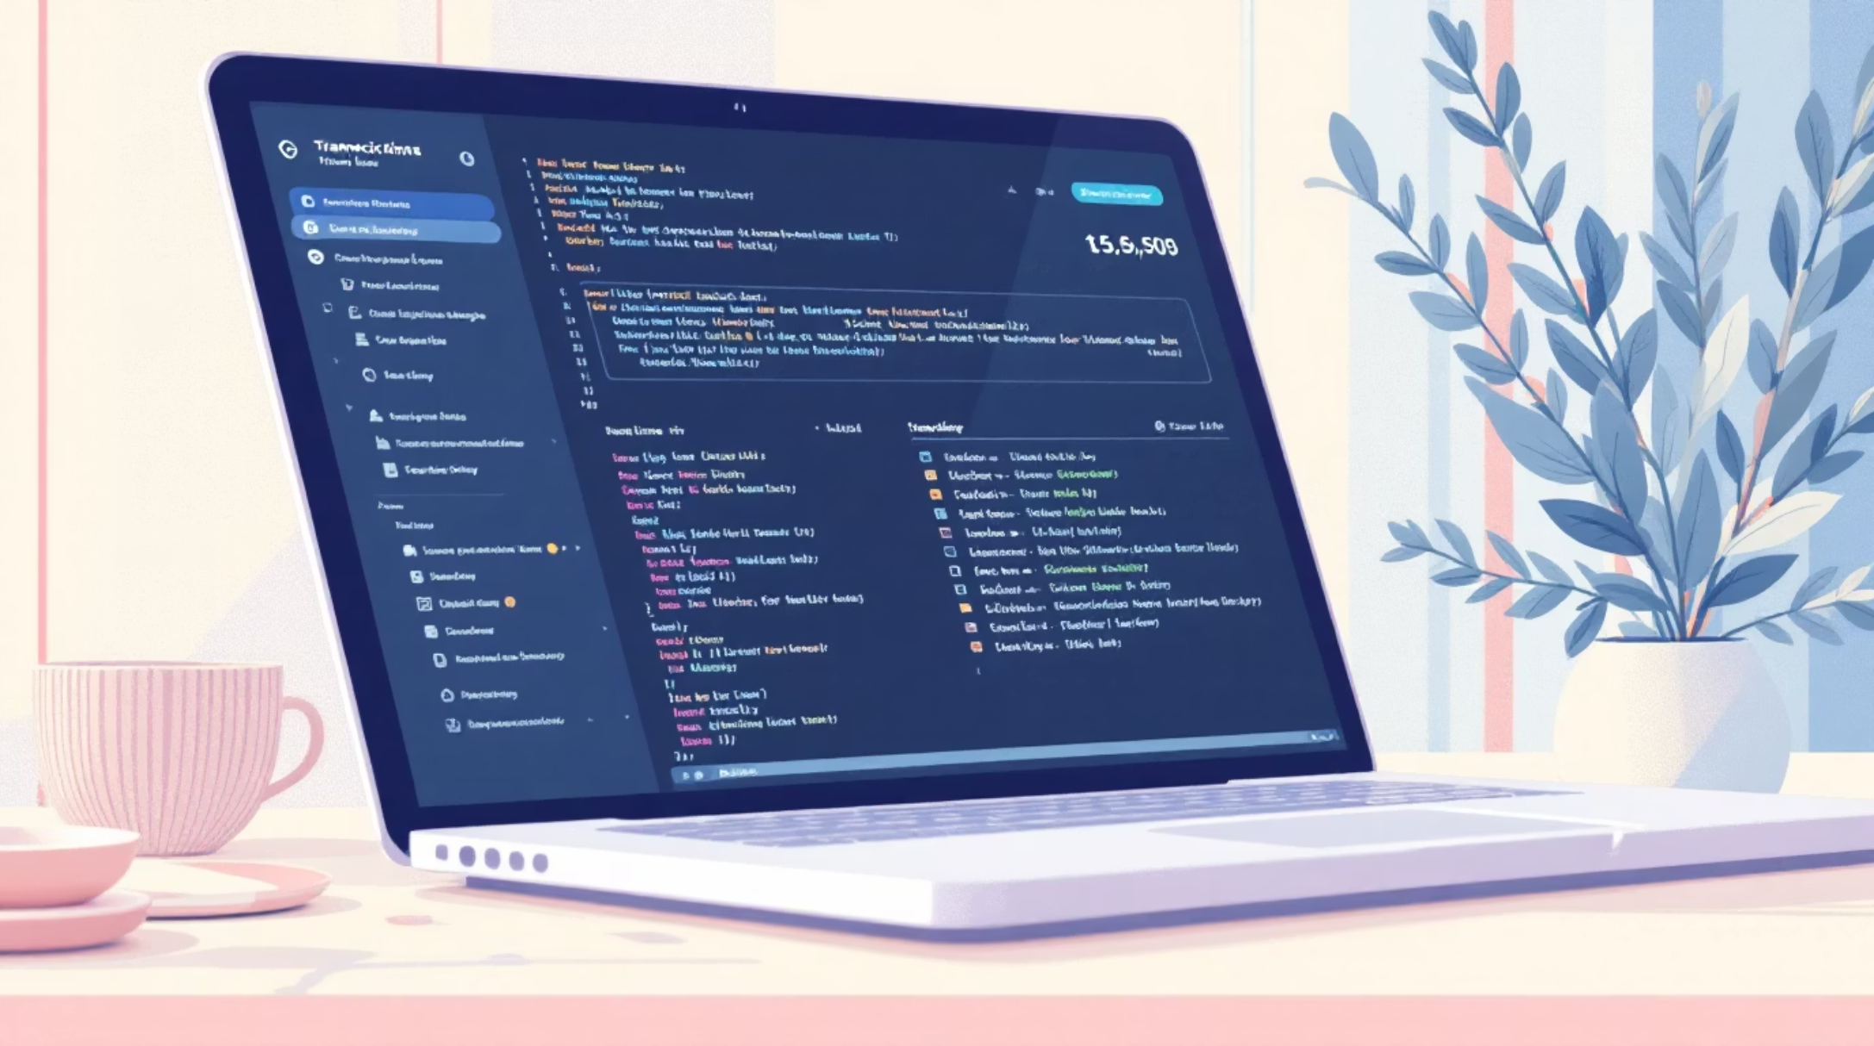
Project Overview
Objective
Uncover insights from purchase, demographic, and engagement data to improve targeting, product mix, and subscription conversions.
Scope
3,900 rows × 18 columns covering demographics, purchases, behavior, and shipping.

Slide 3

Data Summary
Total Records
Columns
Missing Data
3,900 purchases across multiple categories
18 features including demographics, purchase details, and engagement
37 missing values in Review Rating — handled by median imputation per category

Slide 4

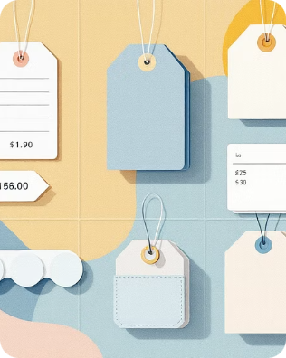
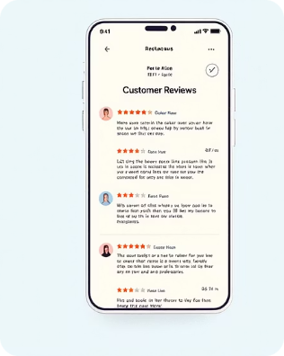
Key Features
Customer Demographics
Purchase Details
Engagement
Item, category, amount, season, size, color
Discounts, promo usage, frequency, previous purchases, review rating, shipping
Age, gender, location, subscription status

Slide 5

EDA — Python Workflow
Loaded data with pandas; used df.info() and df.describe()
Imputed missing Review Ratings with category median
Renamed columns to snake_case for readability
Engineered age_group and purchase_frequency_days
Cleaned DataFrame exported to PostgreSQL for further analysis.

Slide 6

MySQL Analysis — Revenue by Gender
Compared total revenue generated by male vs female customers. (Chart created from MySQL summary.)
Use findings to tailor gender-focused promotions and product assortments.
Male
Female

Slide 7
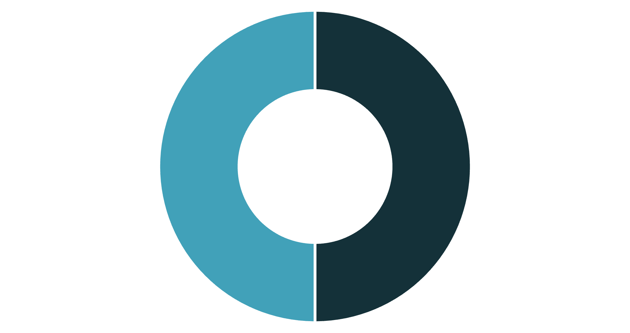
Subscribers vs Non-Subscribers
Compared average spend and total revenue by subscription status. Insights inform retention and acquisition strategies for subscribers.
Subscriber
Non-Subscriber

Slide 8
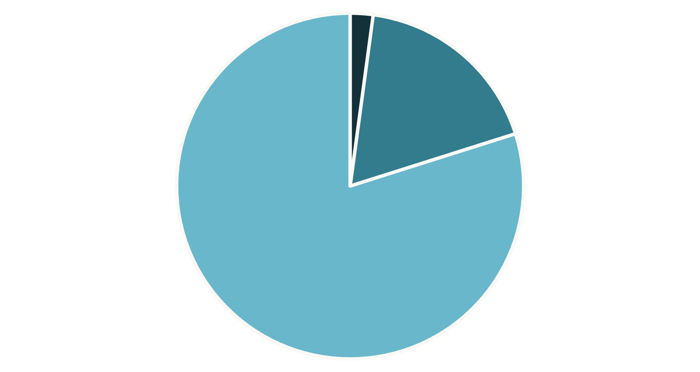

Customer Segmentation
Customers classified as New, Returning, and Loyal based on purchase history. Use segments to personalize communications and offers.
New
Returning
Loyal

Slide 9
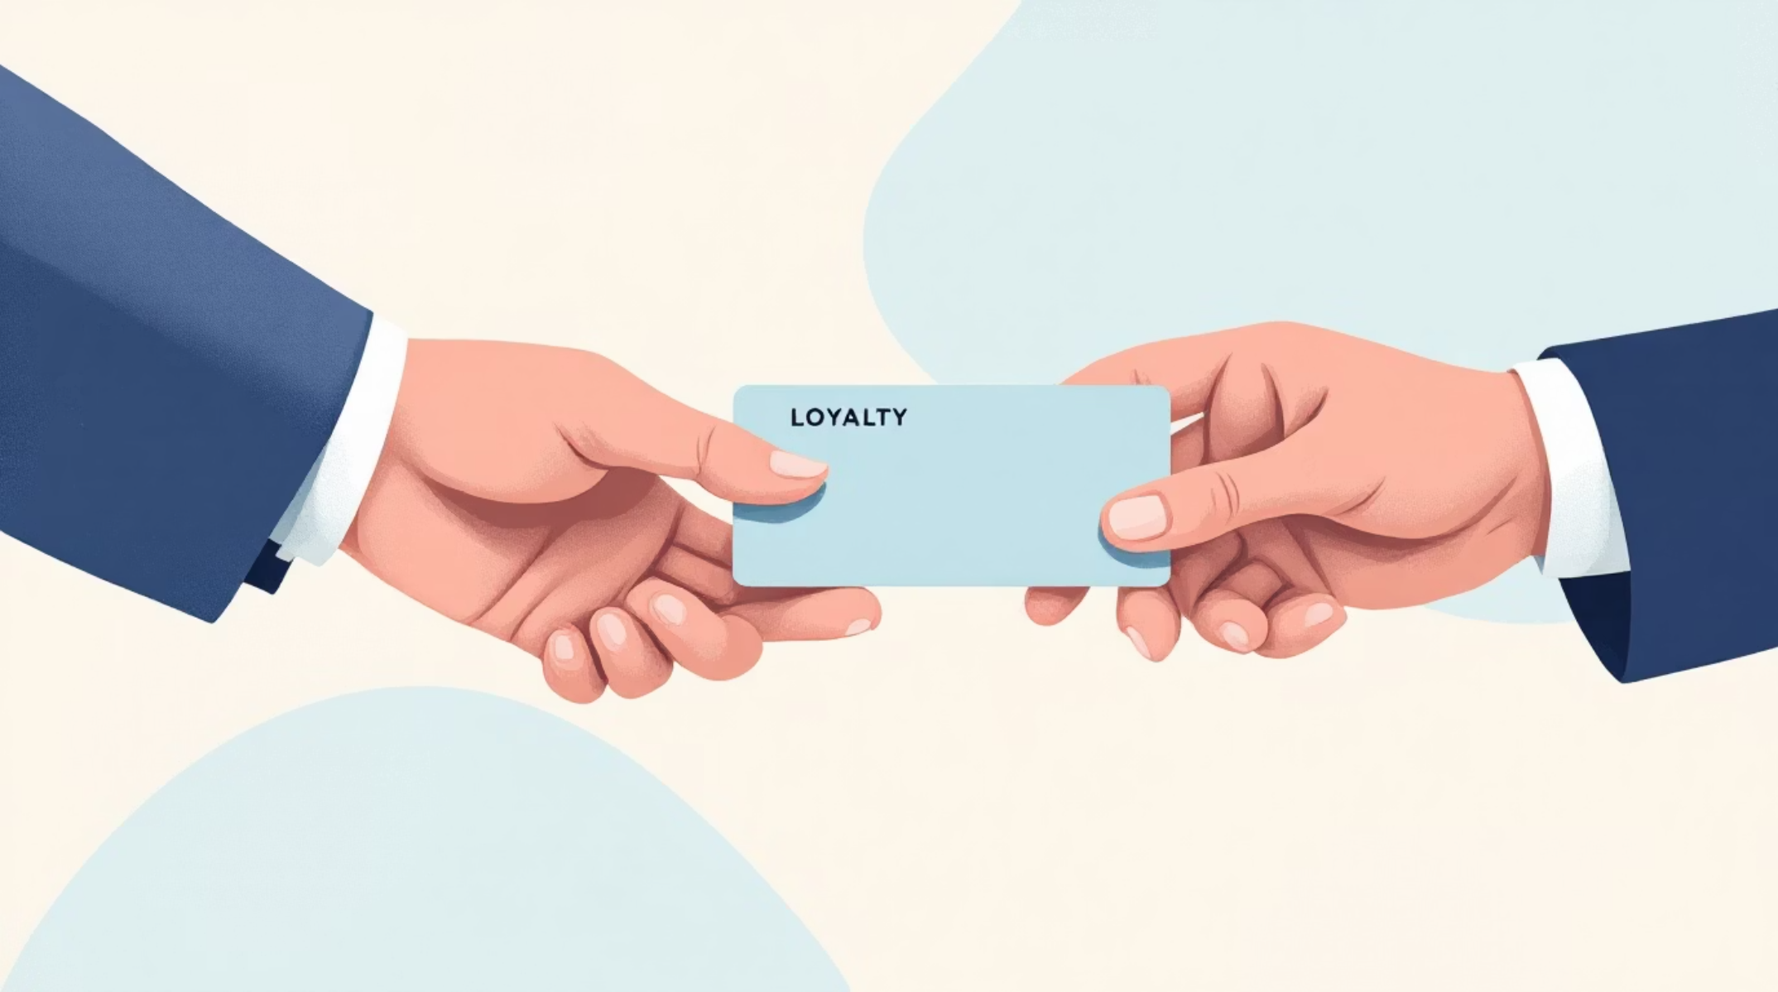
Repeat Buyers & Subscription Tendency
Analyzed whether customers with >5 purchases are more likely to subscribe. Findings guide loyalty incentives and conversion tactics for repeat buyers.
Repeat Purchases
Action
Customers with higher purchase counts show stronger subscription propensity.
Target frequent buyers with subscription trial offers and tailored perks.

Slide 10
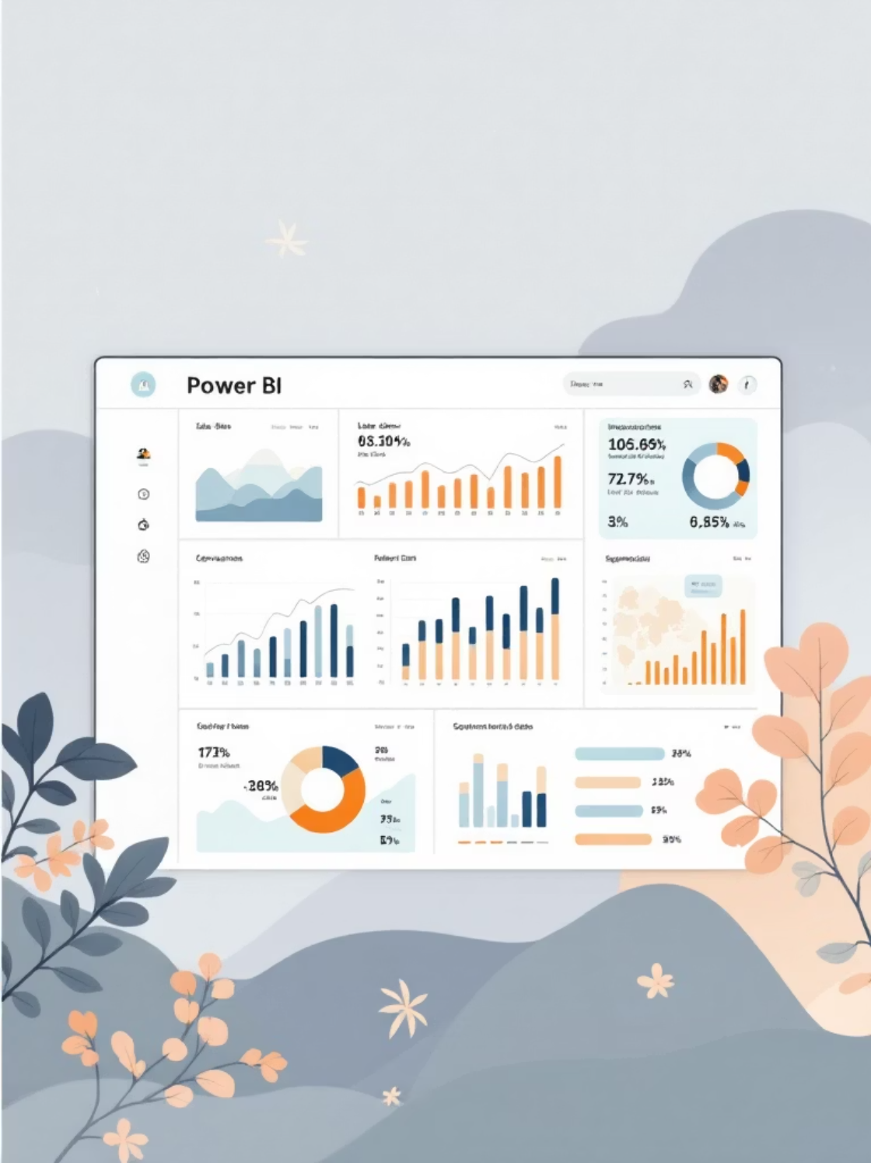
Dashboard & Business Recommendations
Target the Right Age Group
Focus marketing on the age group with the highest purchases.
Reward Frequent Customers
Offer loyalty benefits and special offers to frequent buyers.
Promote High-Rated Products
Feature and stock products with strong review ratings.
Simplify Discounts
Use straightforward discounts rather than complex promo codes.
Dashboard ties insights together for stakeholders to monitor and act on trends in real time.

